Slide 1
CS 447/647
Access Control

Slide 2
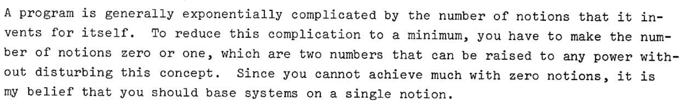
The UNIX Command Language (1976) https://github.com/susam/tucl

Slide 3
Access control not security
Notes:
mechanical details of how the kernel and its delegates make security-related decisions

Slide 4
Standard Unix Access Control
Access control decisions depend on the user
Objects (e.g., files and processes) have owners
You own the objects you create
“root” can act as the owner of any object
Only root can perform certain sensitive administrative operations.
Notes:
User and often group
When you create objects they inherit owners
Settimeofday, kill, hostname and networking

Slide 5
Filesystem Access Control
Each file has an owner and group
chown user:group file
chmod 700 somedir
find . -type d -exec chmod 700 {} \;
Owner specifies what operations (syscalls) the group can perform (rwx)
open(2) - open and possibly create a file
O_APPEND - Append to file
O_CREAT - Create file if it doesn’t exist
int open(const char *pathname, int flags);
EACCES - The requested access to the file is not allowed
read(2)
write(2)
close(2)

Slide 6
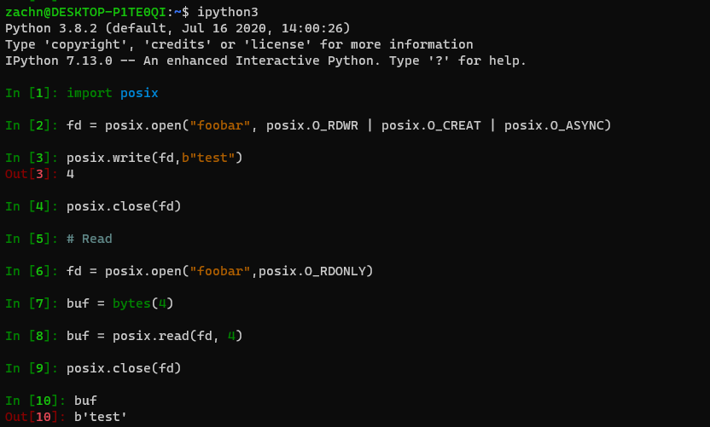
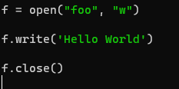
open(2)

Slide 7
Process Ownership
Processes have owners
You can look them up with the “ps” command
ps aux | grep bash
You can also check in /proc
ls -la /proc
Owners can send signals to their processes
kill(1), which calls kill(2) - man 7 signal
kill -SIGTERM 2000 - posix.kill(2000, 15) #Python kill(2)
kill -SIGKILL 2000 - posix.kill(2000, 9) #Python kill(2)
Some signals can be used to interact
SIGUSR1 {10} - User defined signal
SIGINT
Notes:
a - Lift the BSD-style "only yourself" restriction
u - user-oriented format
x - Lift the BSD-style "must have a tty" restriction
SIGSTOP
SIGCONT

Slide 8
root account
Superuser account
Can perform any file or process operation
Can execute restricted syscalls
settimeofday(2)
Only root can
Create device files
Set the system clock
Set the system’s hostname
Configure network interfaces
Open privileged network ports (those numbered below 1,024)
Shutting down the system
Can change a processes UID and GID
login - Begins a session as a different user on the system
Notes:
Root can’t modify some pseudo filesystems like /sys

Slide 9
setuid and setguid
Identity substitution
Allows marked executables to run with elevated permissions
typically root
setuid - Set User ID
passwd(1), su(1), login(1), ping(1), singularity(1)
Big security concern
nosuid filesystem option
setguid- Set Group ID

Slide 10
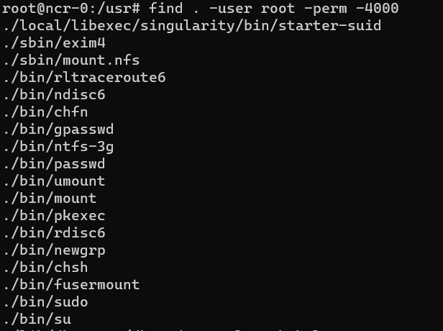

Slide 11
root management
Assign root a password
Forbidden on Ubuntu
Bad practice - No logging
Use the “su” command
Prompts for root’s password
Logs who su’d
Can be used by root to login as other users
su newellz2 -c "whoami"
sudo
Superuser Do
Often the best solution

Slide 12
sudo
Configured with the /etc/sudoers file
Use visudo to edit it
Allows running commands as root and other users
sudo -U backup /usr/local/bin/backup.sh
Interactive root session
sudo -i
sudo su -
Logging!
sudo sh -c "cd /home ; du -s * | sort -rn > USAGE"
banyan sudo: newellz2 : TTY=pts/13 ; PWD=/home/newellz2 ; USER=root ; COMMAND=/bin/sh -c cd /home ; du -s * | sort -rn > USAGE

Slide 13
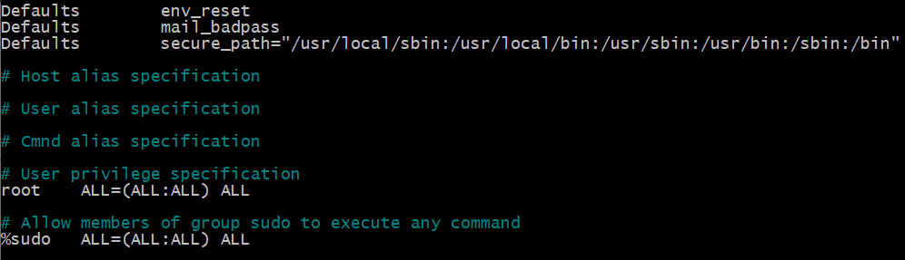
/etc/sudoers
USER\%GROUP HOSTS=(USER:GROUPS) COMMANDS
Notes:
env_reset This causes commands to be executed with a new, minimal environment.
mail_badpass Send mail to the mailto user if the user running sudo does not enter the correct password.
secure_path Path used for every command run from sudo.

Slide 14
sudo advantages
Accountability
Limiting scope
Revoke privileges without changing root’s password
Canonical list of users with privileges
Lessen the likelihood of unattended root shell
Single file for multiple hosts
Lock the root account
passwd -l root

Slide 15
sudo disadvantages
Breach of a user account equivalent to breach of root
Logging can be subverted with shell escapes
Flat file management breaks down with
Large number of hosts
Large number of users

Slide 16
News
A major vulnerability in sudo
https://lwn.net/Articles/844789/
buffer overflow
Inside the utility since 2011
Test with
sudoedit -s '\' `perl -e 'print "A" x 65536'`
C programming error leading to a complete compromise of a setuid-root program

Slide 17
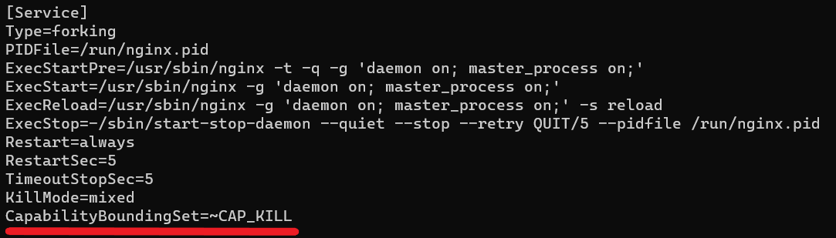
Advanced Access Control - Capabilities
Divides the privileges traditionally associated with superuser into distinct units
CAP_KILL - Has the abilities to kill a process
CAP_FOWNER - Filesystem owner permissions
CAP_NET_ADMIN - Network administration permissions
CAP_NET_BIND_SERVICE - Bind to ports < 1024
CAP_REBOOT - Reboot the system
CAP_SYS_ADMIN - Sweeping root privileges (mount, unmount, create namespaces, etc.)

Slide 18
Advanced Access Control - Namespaces
Segregate processes into hierarchical partitions
clone(2) system call
Files (mount+chroot)
Networking
PIDs
UIDs
Mount
Foundation of containers!
ip netns add test ip netns exec test ip addr #Nothing

Slide 19
What is SELinux?
Security-Enhanced Linux (SELinux): A mandatory access control (MAC) mechanism for Linux.
DAC - Discretionary Access Control (traditional UNIX Access Control)
MAC - Mandatory Access Control (removes discretionary powers of file owners in favor of centralized policies)
Developed by the NSA, integrated into the Linux kernel.
Policies define how processes and resources interact, enforced at the kernel level.

Slide 20
DAC vs MAC
Access control decisions are made by the resource owner
Users can modify permissions of their own files
Relies on traditional Unix file permissions (owner, group, others) to control access
Root has ultimate control
Access control is enforced by the system based on security policies.
Users cannot override system-enforced security policies.
Security policies are enforced regardless of user ownership to control access
Root is also subject to policies

Slide 21
MAC Benefits and Drawbacks
Improving security
Improving scalability of multi-user systems
Keeping user processes isolated from each other
Prevents unauthorized resource access
Compliance requirements
Some regulatory frameworks, such as PCI-DSS (Payment Card Industry Data Security Standard) require strict access controls that are much easier to implement with MAC
Configuration complexity
Policies can be time-consuming to configure correctly
Improper configurations can easily lock you out of the system
Some applications require custom security policies
Default behavior of some applications may make them try to read/write to directories blocked by MAC
Some legacy (pre-SELinux) applications run with the assumption that they can access any file as root

